Slide 1

Smart Research Assistant
Trusted, cited answers from research papers — with live update tracking
Team: [H. UdayKumar] (Lead), [P. Venkata Teja] (Frontend), [S. Sairam] (Designer), [K. Bhanu] (Research/Support), [M. Madhan] (Research/Support)
Email: [udaykumarhaibathi@gmail.com]
HackwithHyderabad Hackathon — Problem Statement: Smart Research Assistant

Slide 2

Problem Statement
Researchers face information overload with long research papers.
Existing AI/chatbots give uncited or outdated answers.
Tracking new updates on a paper/topic is difficult.
Example: A student spends hours verifying accuracy from multiple sources.

Slide 3

Why Existing Tools Fail
Search Engines → Only give links, no direct answers.
Chatbots → Often uncited, sometimes outdated.
Summarizers → Lose context, miss updates.
No single tool ensures citations, freshness, and trust.

Slide 4
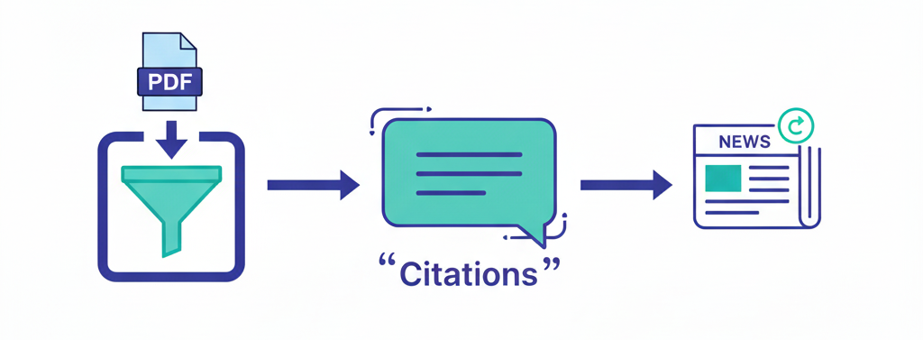
Our Solution
An AI-powered research assistant that delivers cited answers from uploaded papers and keeps you updated with latest news and improvements.
Multi-doc retrieval with citations from source pages.
Citation-first answers → always show evidence.
Subscription updates on relevant topics
.
Flexprice model → usage-based credits system.
Your research companion that ensures trust, freshness, and efficiency.

Slide 5







How It Works
Upload & parse
User uploads research papers (PDFs).
Chunk & embed
Paper is split into smaller sections.
Topic profile
System builds keywords from paper.
Local retrieval first
Answer pulled directly with citations.
LLM fallback
If unclear, system generates a concise synthesis.
Subscription updates
Tracks new news and delivers deltas.
Efficient pipeline → Retrieval first, LLM only when needed, updates always tracked.

Slide 6

MVP Features
UI Mock (Already Prepared)
Upload & parse PDFs (UI flow only)
Local retrieval with citation chips (mock data)
Chat UI (static Q&A with fake citations)
Subscription toggle + update badge (visual only)
Credits/usage log (fake counter for Flexprice demo)
Hackathon Build (Will Implement)
Connect embedding + retrieval backend (real doc search)
Integrate Gemini API (LLM fallback) for out-of-paper queries
Implement basic subscription polling for updates (news scraping / API)
Make credits log functional (deduct tokens on LLM use, not just mock)
Our MVP focuses on UI, usability, and proof of concept — backend integrations will follow.

